Slide 1


Slide 2

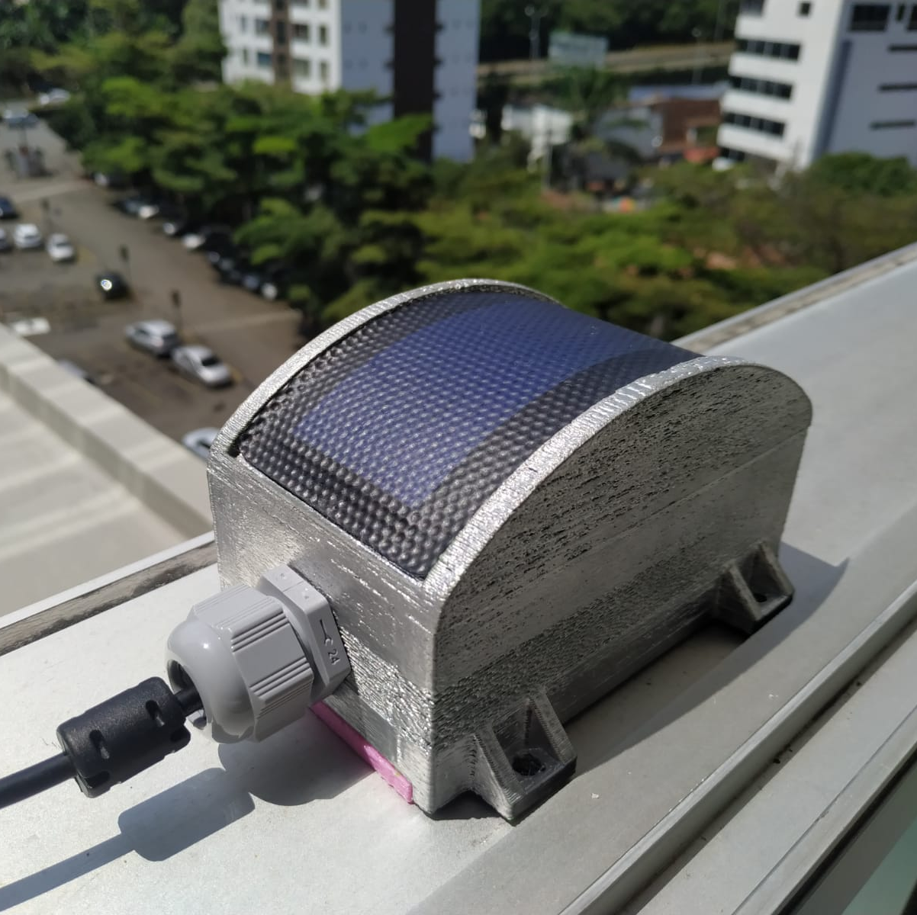
Author:
Felipe Mendoza Giraldo
Development of instrumental device to measure the Solar irradiance
Presented to:
Alejandro Marulanda Tobón Álvaro Andres Velasquez Torres
Scientific intrumentation
Physical science department
School of Aplied science and Engineering
June 22, 2022

Slide 3
Theoretical frame 1.1. Solar irradiance
1.2. Solar instrumentation
2. Objectives development
3. Conclusions
Content

Slide 4

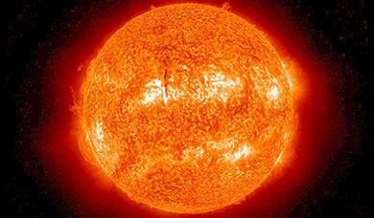
Theoretical frame
1

Slide 5
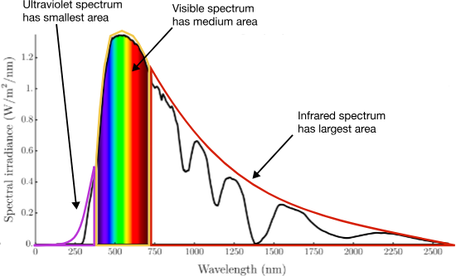

Solar irradiance
Definition: Amount of power of the light of the sun hitting in a square plane each second
Units: $[\frac{W}{m^{2}}]$
Image taken from: https://brilliant.org/practice/spectral-properties-sunlight/
5

Slide 6
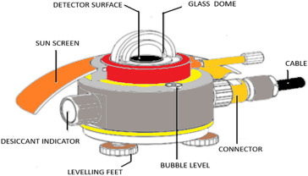
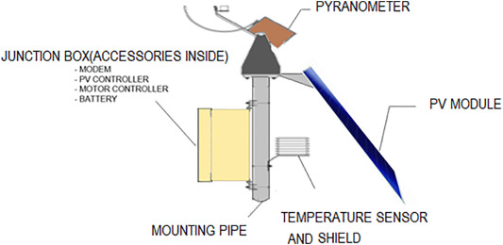
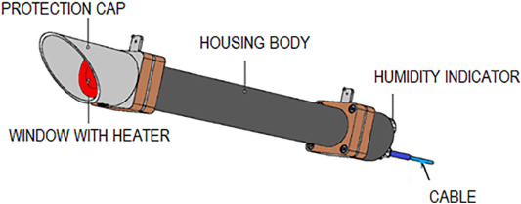
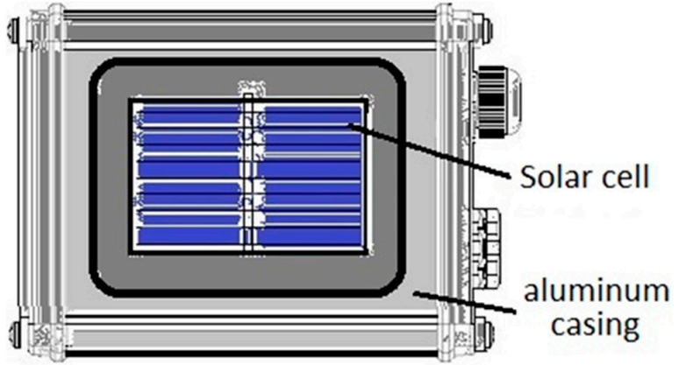
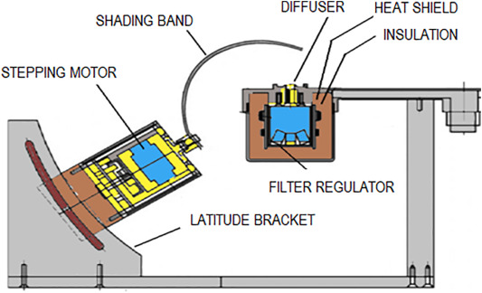
Solar instrumentation
1)
Types of instruments:
Pyranometer
Pyrheliometer
Multi-Filter Rotating Shadow Band Radiometer
Rotating shadow-band radiometer (RSR2)
Silicon Sensors
4)
2)
5)
3)
2

Slide 7
General Objective:
To develop an instrumental device to measure the solar irradiance based in a solar cell generation to predict and optimize the generation of a photovoltaic system.
Specific Objectives:
To design the instrument following the Ulrich methodology.
To design the electronic of the system to design and obtain the measure of the solar irradiance.
To develop a mathematical model for the solar cells based in the literature to simulate the system.
To develop and calibrate the instrument.
To evaluate the performance of the instrument when it is installed in a photo-voltaic system measuring the solar irradiance and determining the generated power of the system.
Objectives
1

Slide 8
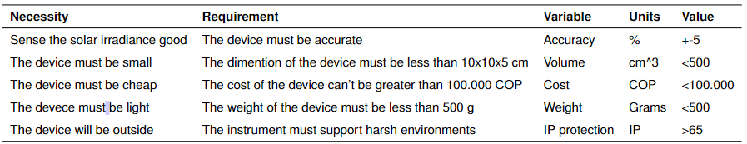
To design the instrument following the Ulrich methodology.
PDS
5

Slide 9
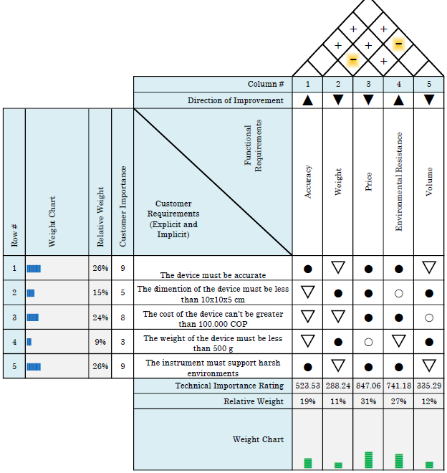
To design the instrument following the Ulrich methodology.
HOQ
5

Slide 10
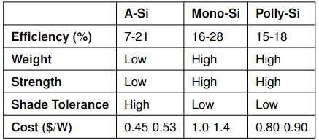
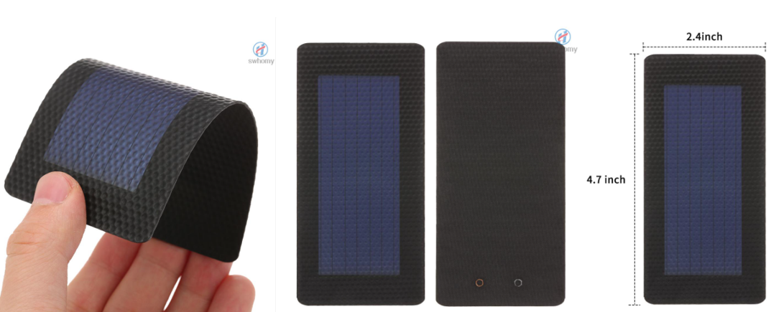
To design the instrument following the Ulrich methodology.
Cells comparison
Types of cells
Amorphous Silicon Solar Cell (A-Si)
Micro morph Cells (Tandem-Cell Using a-Si/c-Si)
Monocrystalline Solar Cell (Mono-Si)
Polycrystalline Solar Cell (Multi-Si)
Black Silicon Solar Cells
Cell selected
5

Slide 11
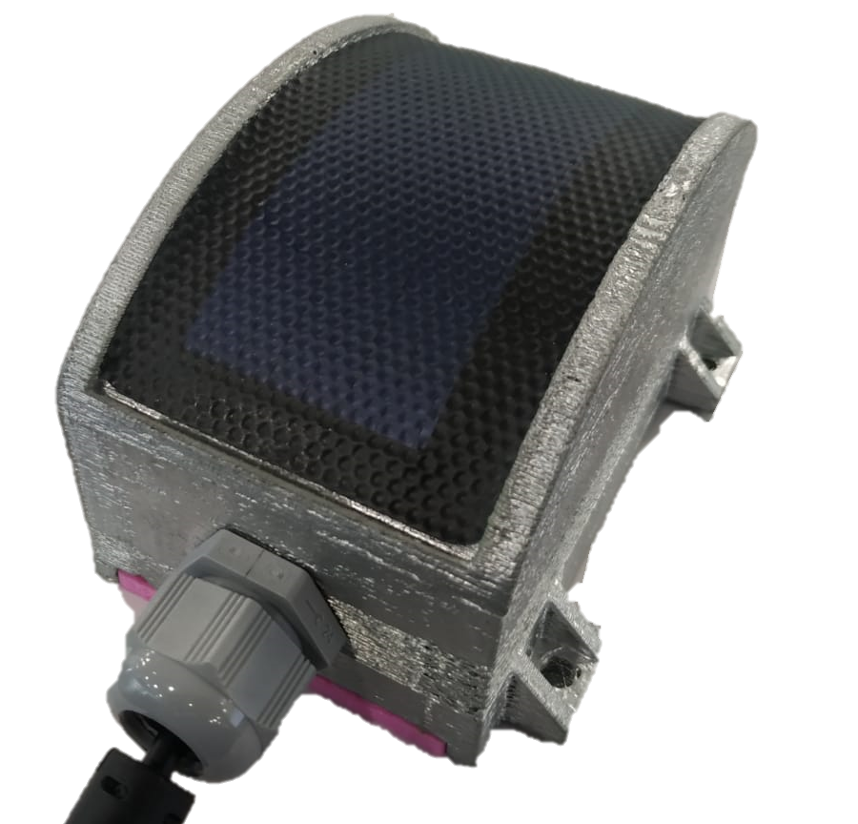
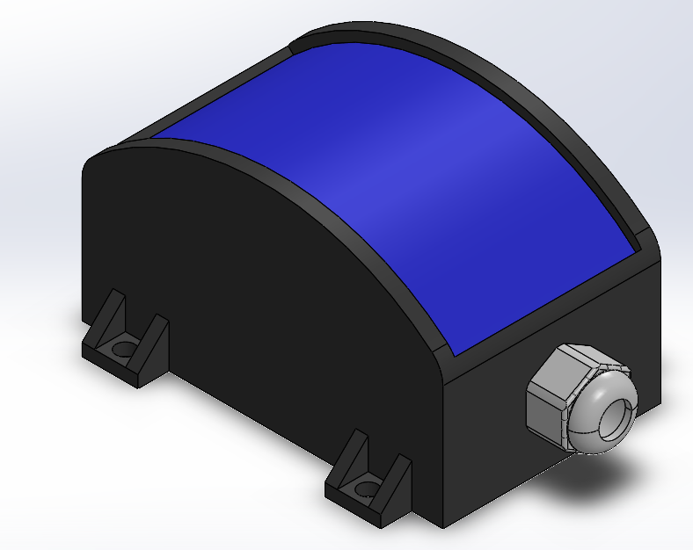
To design the instrument following the Ulrich methodology.
Final design
5

Slide 12
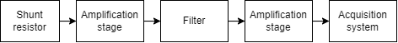
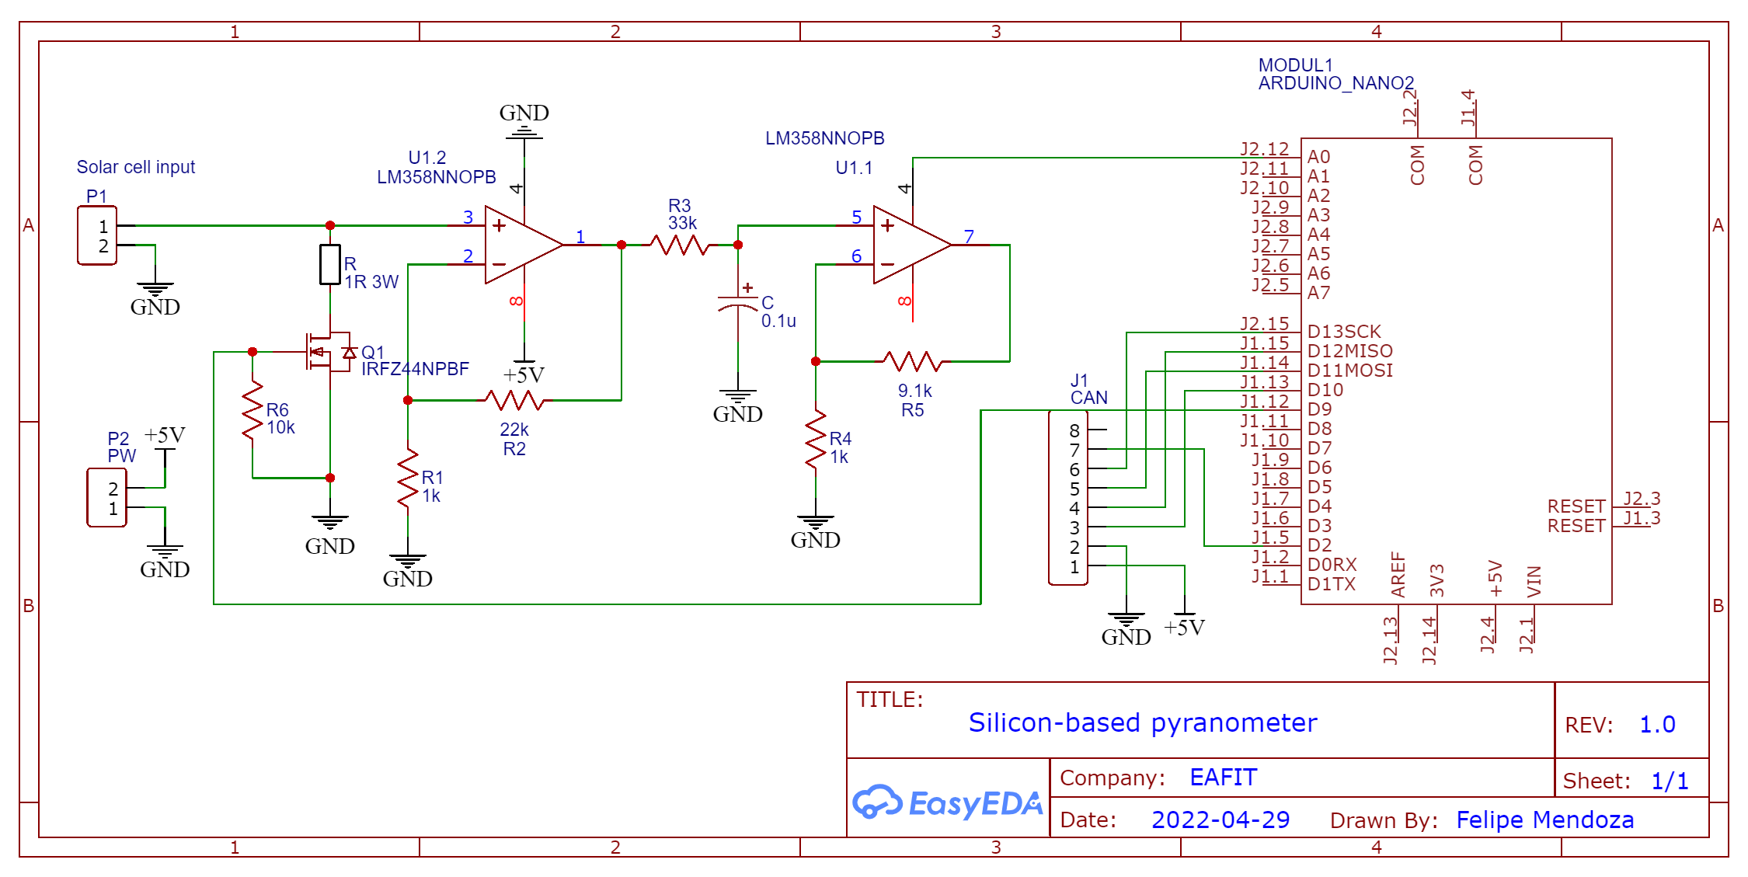
To design the electronic of the system to design and obtain the measure of the solar irradiance.
Circuit Block diagram
Schematic
5

Slide 13
To design the electronic of the system to design and obtain the measure of the solar irradiance.
Circuit Block diagram
Schematic
5

Slide 14
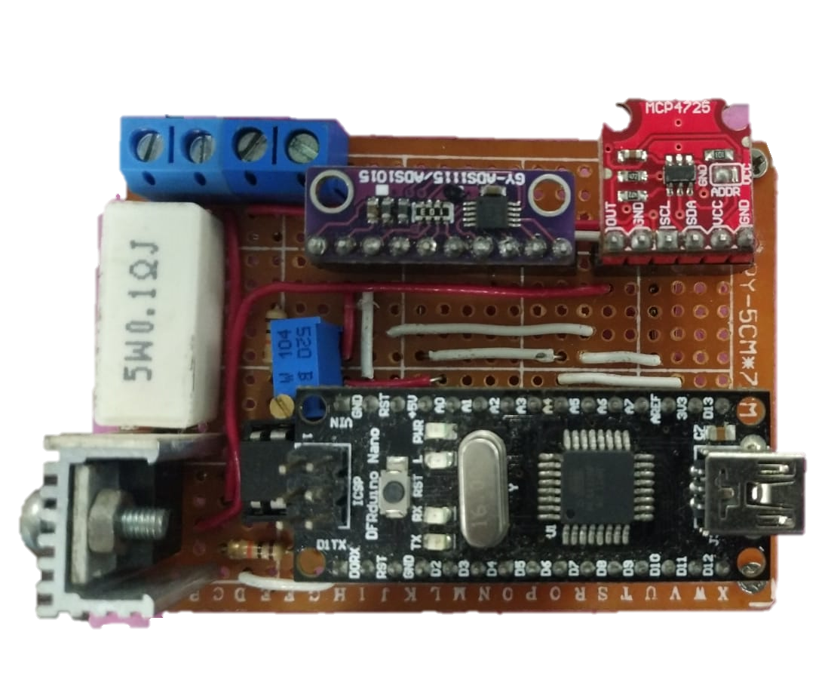
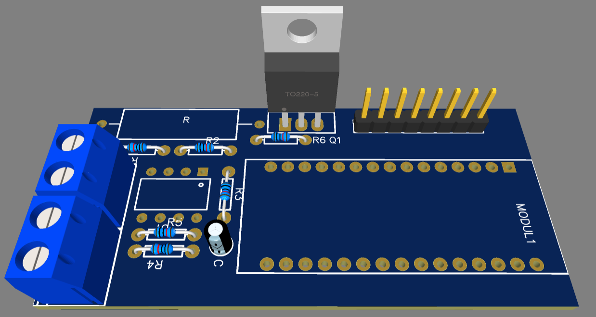
To design the electronic of the system to design and obtain the measure of the solar irradiance.
PCB Design
5

Slide 15
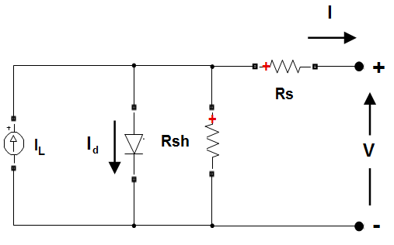

To develop a mathematical model for the solar cells based in the literature to simulate the system.
5

Slide 16
To develop and calibrate the instrument.
Curves obtained with the instrument at different solar irradiations
5

Slide 17


To develop and calibrate the instrument.
$$r^{2}=0,8437$$
$$G\left(a\right)=2.22e3 [1/m^{2}]a+248.07[W/m^{2}]$$
5

Slide 18
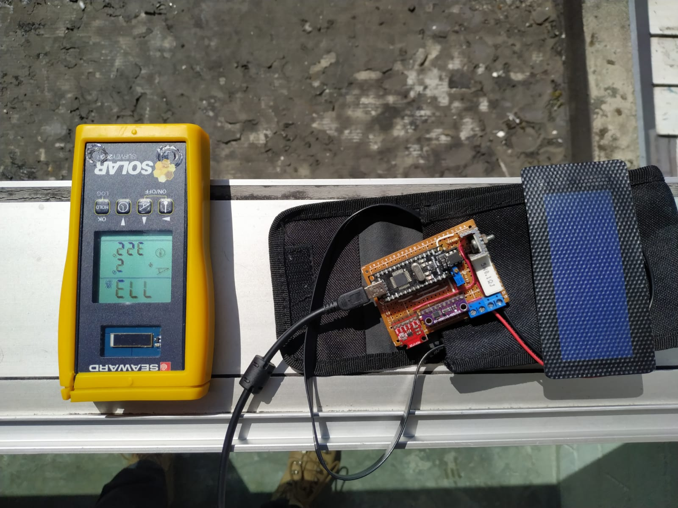
To evaluate the performance of the instrument.
Experimental setup
Pyranometer to read the solar irradiance and to calibrate the cell
5

Slide 19
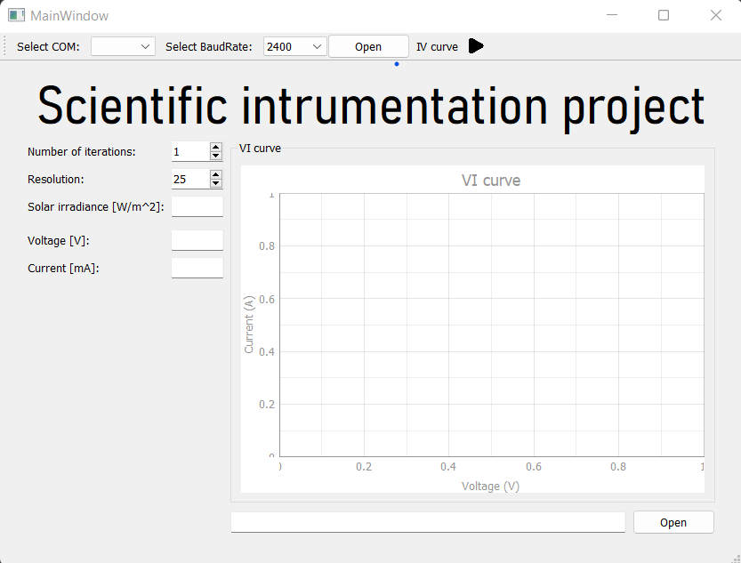
To evaluate the performance of the instrument.
Select the COM port and BaudRate.
Select the number of iterations in the measurement and the resolution.
Run the program to obtain the irradiance
5

Slide 20
Conclusions and obsevations
Calculate the solar irradiance from the area under the VI curve could improve the performance and the accuracy of the system.
The temperature must be controlled or measured to improve the performance of the instrument.
With a better cell its possible get better measurements.
A xenon lamp is needed to calibrate the instrument accurately in different solar irradiations
5

Slide 21
Referencias
A. R. Pazikadin, D. Rifai, K. Ali, M. Z. Malik, A. N. Abdalla, and M. A. Faraj, “Solar irradiance measurement instrumentation and power solar generation forecasting based on artificial neural networks (ann): A review of five years research trend,” Science of The Total Environment, vol. 715, p. 136848, 2020. [Online]. Available: https://www.sciencedirect.com/science/article/pii/S0048969720303582
L. Solar, “Best Monocrystalline Solar Panels - Alternative Energy Sources,” https://alternativeenergysourcesv.com/best-monocrystalline-solar-panels/, apr 8 2018, [Online; accessed 2022-04-27]
A. Adam, “Polycrystalline vs. Monocrystalline Solar Panels: Which Is Better?” https://offgridtiny.house/polycrystalline-vs-monocrystalline-solar-panels-which-is-better/, dec 24 2017, [Online; accessed 2022-04-27].
A. Hunt, “Amorphous vs crystalline solar panels: What’s the difference?” https://solarsmarts.co/amorphous-vs-crystalline-solar-panels/, jul 21 2021, [Online; accessed 2022-04-27].
W. Abd El-Basit, A. El–MAKSOOD, and F. Soliman, “Mathematical model for photovoltaic cells,” Leonardo Journal of Sciences, vol. 12, pp. 13–28, 12 2013.
https://cccrg.cochrane.org/infographics

Slide 22

¡Thanks!

